Slide 1

Files

Slide 2
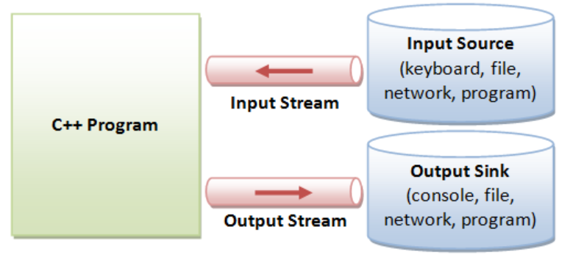
Streams
C/C++ IO are based on streams, which are sequence of bytes flowing in and out of the programs
just like water and oil flowing through a pipe
In input operations, data bytes flow from an input source (such as keyboard, file, network or another program) into the program
In output operations, data bytes flow from the program to an output sink (such as console, file, network or another program)
Streams acts as an intermediaries between the programs and the actual IO devices
Different streams are used to represent different kinds of data flow
For example, the ifstream class represents data flow from input disk files into the program
istream class supports standard input
ostream class supports standard output
ifstream class supports file input
ofstream class supports file output

Slide 3
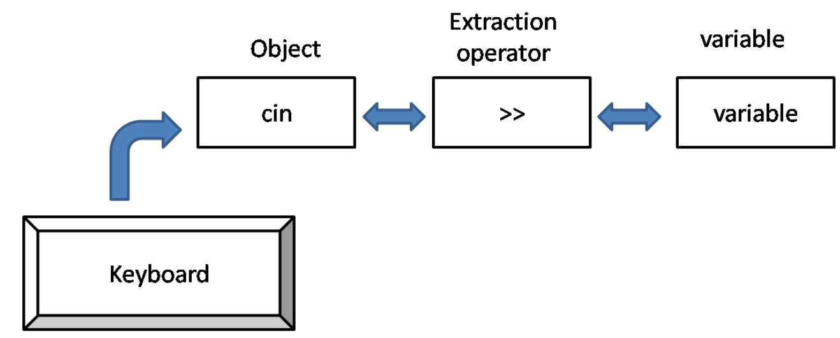
In C++ a stream is represented by an object of a particular class. like the cin and cout are stream objects.
C++ provides both the formatted and unformatted IO functions.
In formatted or high-level IO, bytes are grouped and converted to types such as int, double, string or user-defined types.
In unformatted or low-level IO, bytes are treated as raw bytes and unconverted.
Formatted IO operations are supported via overloading the stream insertion (<<) and stream extraction (>>) operators,
Advantages of Streams
One reason is simplicity like we can avoid getting confused with formatting characters like (%d,%f etc...) as we use in "C".
Another reason is that you can overload existing operators and functions, to work with user defined data type
which makes programming easier and more error free.

Slide 4
Disk File I/O with Streams :
Most programs need to save data to disk files and read it back in
Three classes: ifstream for input, ofstream for output and fstream for both input and output
we can use their member functions to read and write to the files.
The ifstream, ofstream, and fstream classes are declared in the FSTREAM file.

Slide 5
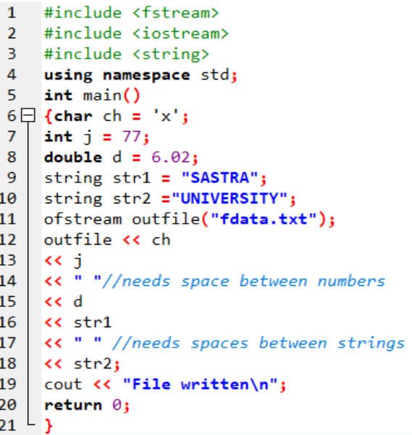
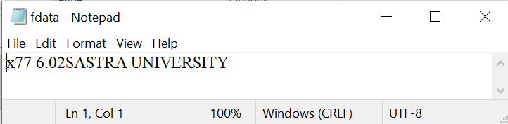
Writing Data:
If the file doesn‘t exist, it is created. If it does exist, it is truncated and the new data replaces the old.
When the program terminates, the outfile object goes out of scope.
This calls its destructor, which closes the file, so we don‘t need to close the file explicitly.
Output:
File written

Slide 6
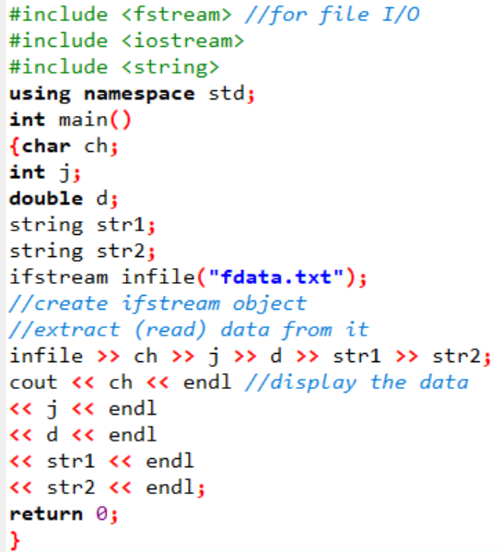
Reading Data
Output:
x
77
6.02
SASTRA
UNIVERSITY

Slide 7
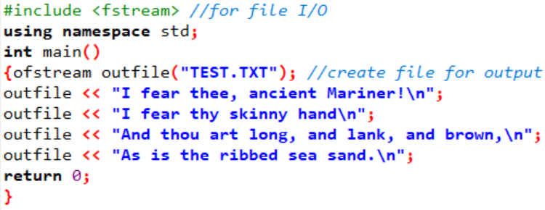
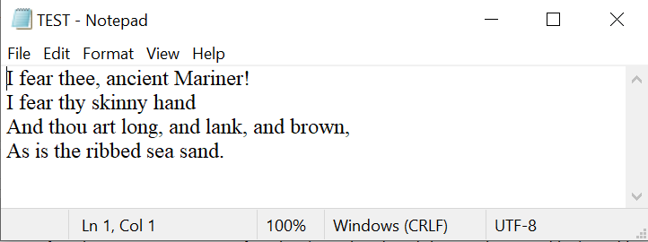

Slide 8
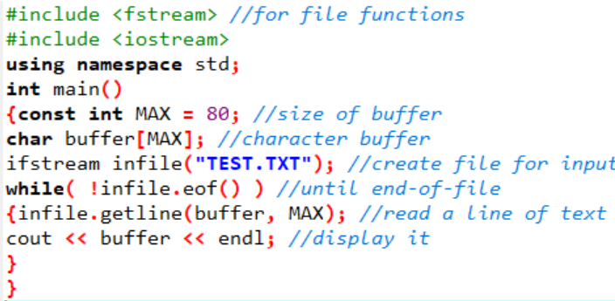
Output:
I fear thee, ancient Mariner!
I fear thy skinny hand
And thou art long, and lank, and brown,
As is the ribbed sea sand.
while( !infile.eof() ) // until eof encountered.
while( infile.good() ) // until any error encountered.
while( infile ) // until any error encountered.

Slide 9
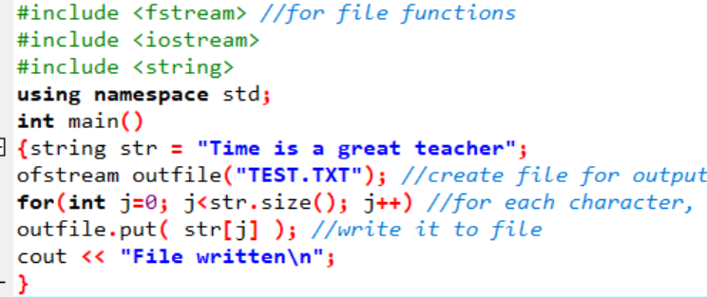
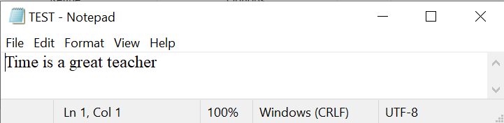
Character I/O
The put() and get() functions, which are members of ostream and istream, respectively, can be
used to output and input single characters.

Slide 10
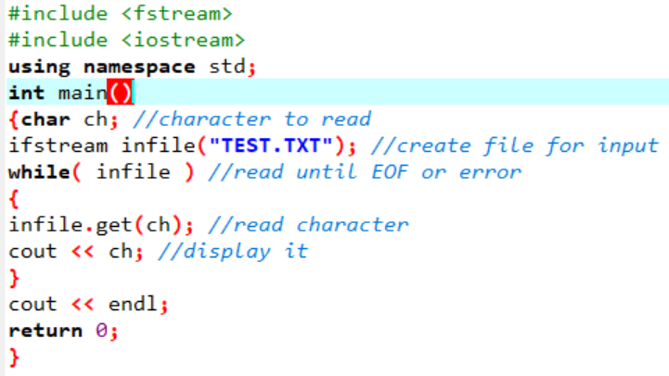
Reading from the files using get function
Output:
Time is a great teacher

